Slide 1
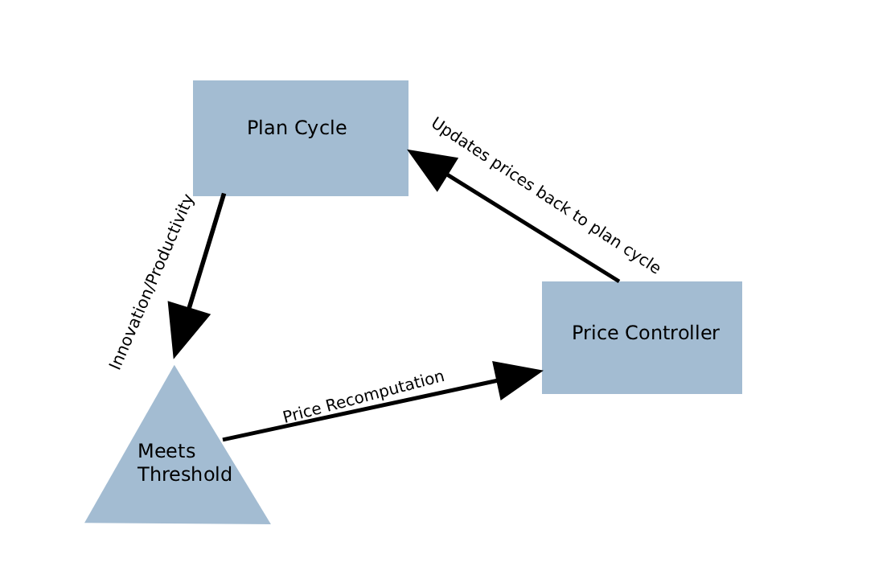
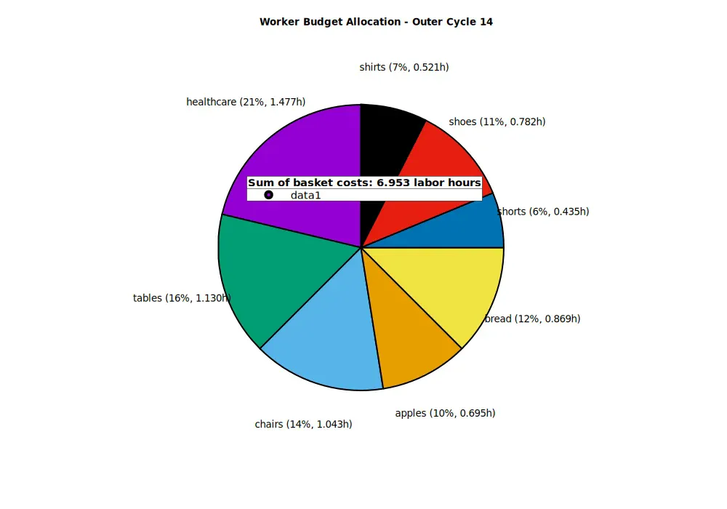
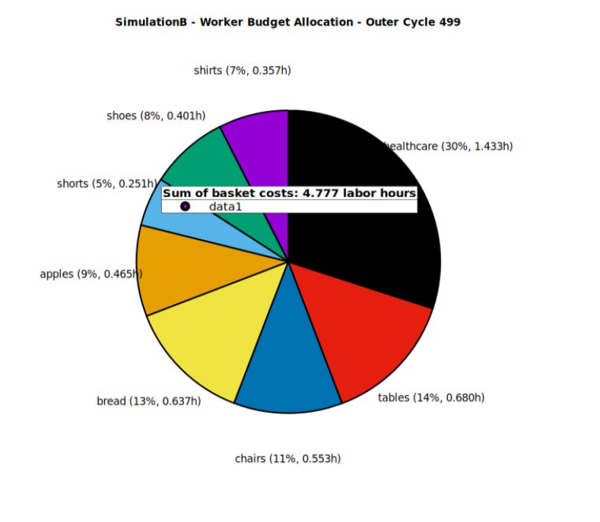
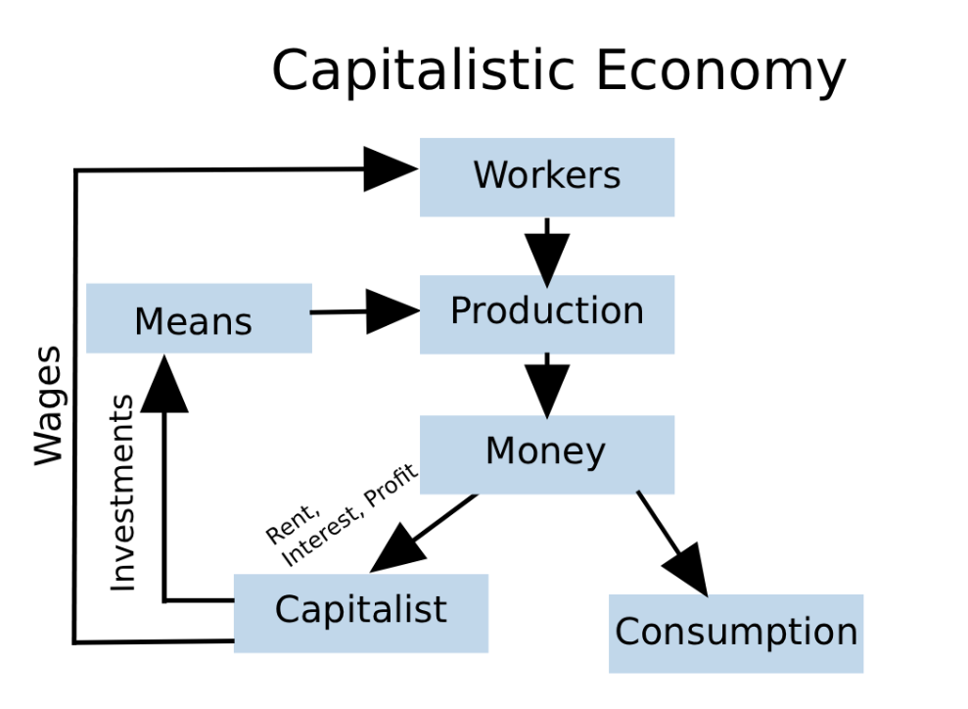
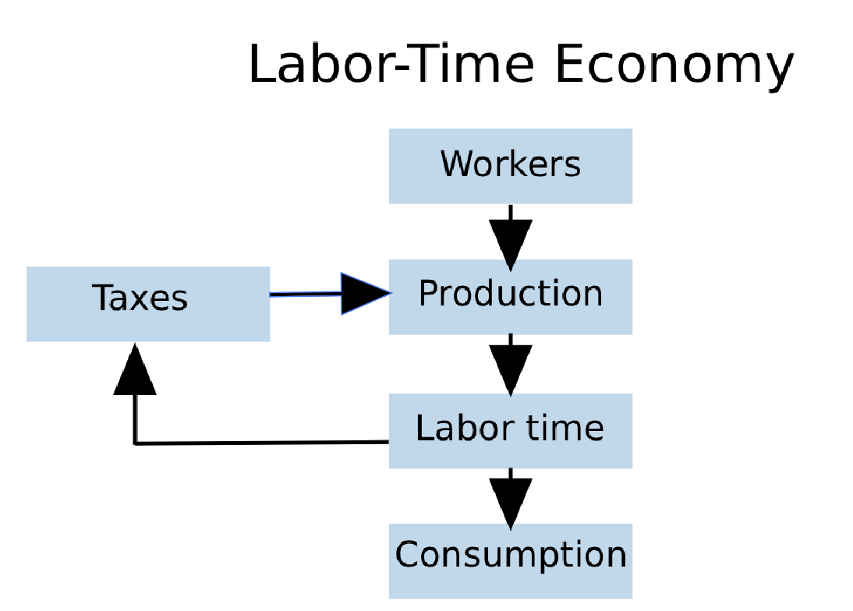
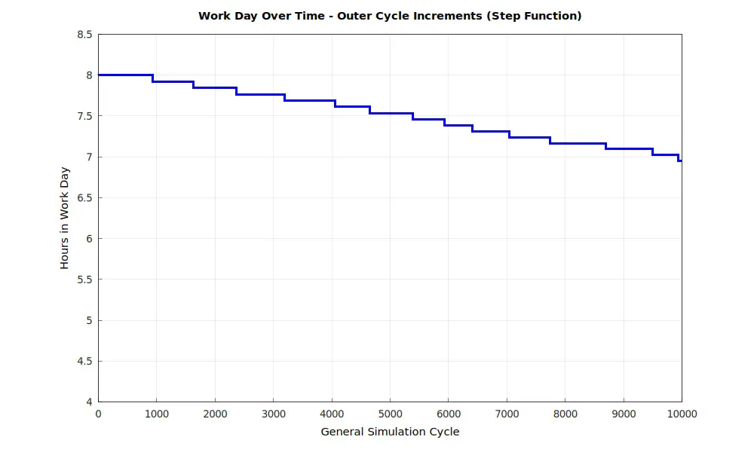
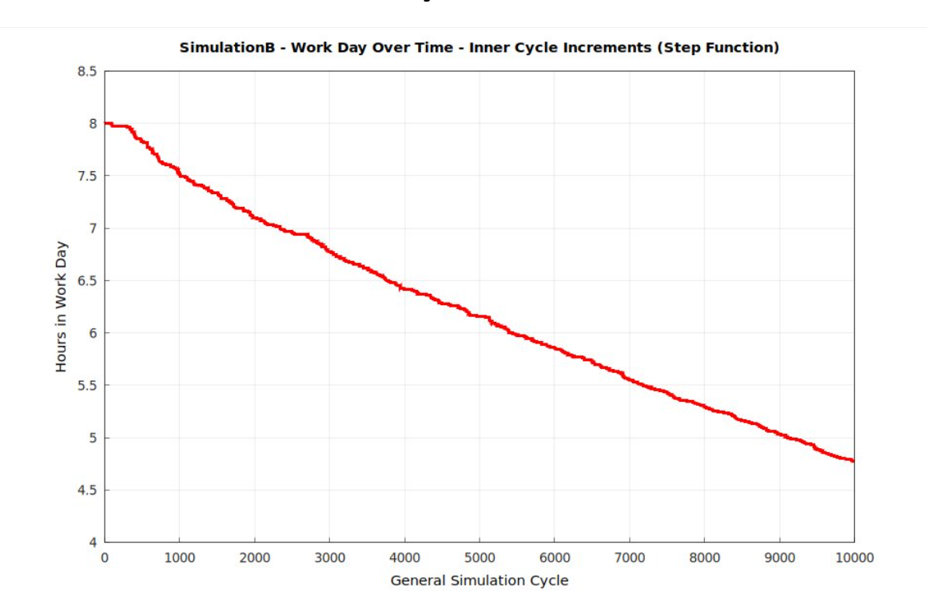
Sharing Productivity Benefits in a Labor-Time Economy
Salamun Nuhin*. Advisors: Alexander Creiner*, Ivan Williams**, Amittai Aviram* (*Boston College, **UMass)
Background
Methods
Results
The capitalist productivity paradigm creates a fundamental contradiction: worker innovations primarily benefit capital owners while innovators face job insecurity through layoffs and work intensification. This creates perverse incentives where workers rationally resist productivity improvements to preserve employment, asking "Why should I innovate myself out of a job while enriching others?"
Current economic structures misalign individual worker incentives with collective productivity goals, resulting in suboptimal innovation rates and economic inefficiency.
This research examines a labor time economy where productivity gains translate directly into reduced working hours for all participants rather than concentrated capital accumulation. Under this framework, innovations benefit workers through decreased labor requirements while maintaining compensation, creating positive incentives for continuous improvement and collective prosperity.
The central challenge is designing economic conditions that encourage productivity improvements without penalizing workers in more efficient sectors. While Toyota's production system shows workers naturally contribute innovations without direct financial incentives, labor-time economies face the problem of workers losing purchasing power when their required hours decrease due to productivity gains.
Two solutions are investigated: (a) system-wide coordination ensuring simultaneous productivity increases across sectors to prevent relative buying power loss, and (b) temporal price adjustment allowing productive sectors shorter schedules while maintaining pre-innovation compensation, with gradual price adjustments only after gains spread sufficiently.
The research uses multi-agent simulation modeling 8 sectors over 10,000 cycles (27 years) with Toyota production parameters. Innovation follows Poisson distribution (15% base probability, 1% variance) generating 1-20% productivity improvements, with price recomputation triggered when ≥4 firms achieve ≥4% efficiency gains.
The research question is determining which approach maintains both innovation incentives and economic stability while preventing purchasing power disparities between sectors.
The simulation reveals critical differences between controlled and uncontrolled productivity distribution. Under price recomputation, workers maintain stable purchasing power as hours decline from 8.0 to 7.0 over 10,000 cycles while budget allocation stays balanced across sectors.
Without price recomputation, significant disparities emerge. Workers in high-productivity sectors see hours drop from 8.0 to under 5.0, but their budget allocation becomes skewed. Healthcare becomes disproportionately expensive relative to reduced labor time, creating affordability crises for workers in other sectors who have less purchasing power due to fewer hours.
With price controls, basket costs remain manageable (6.953 hours in cycle 14 versus 8.000 initially), maintaining proportional access to goods. Without controls, basket costs drop to 4.777 hours but create a two-tier system where less productive sector workers cannot afford the same living standards, especially for healthcare.
This validates the theoretical framework: coordinated price recomputation prevents purchasing power fragmentation that would undermine labor-time economy equity. The controlled mechanism successfully distributes productivity benefits across the workforce rather than concentrating advantages in specific sectors.

